Slide 1
Open House 2020
Natalie Richardson

Slide 2
My Family

Slide 3
Education
1998- Undergraduate degree in Family and Consumer Science, with an emphasis in Interior Design – Freed Hardeman University
2010 –Masters in Special Education (Collaborative K-12) – University of West Alabama
2018 – Certification earned in Elementary Education (K-6)

Slide 4
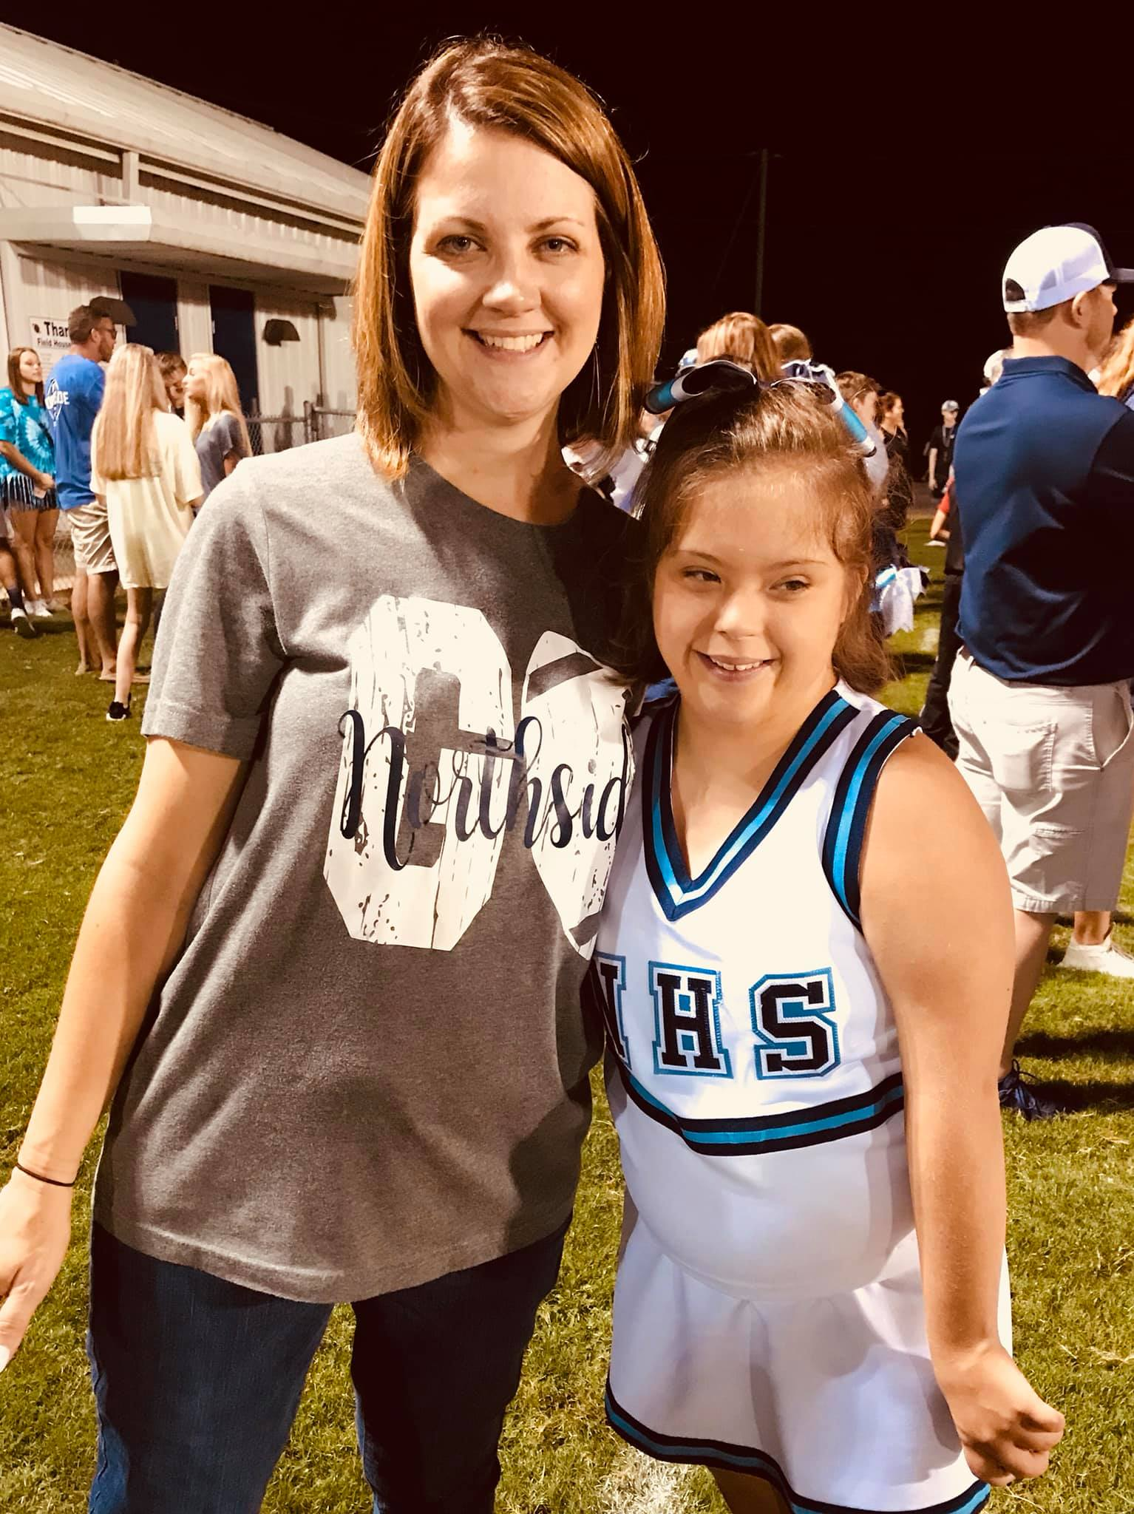
Experiences
Oakman High School, Walker County Schools, Special Education teacher, 7th-9th grades, Inclusion setting
Huntington Place Elementary – Special Education teacher 3rd-5th grades, Inclusion setting
Northside High – Special Education teacher, 9th-12th grades, Self-contained setting

Slide 5
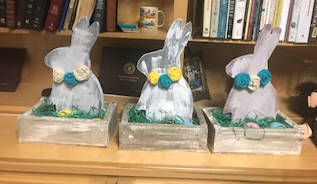
Classes
Alabama Alternate Standards Classes, emphasizing Life Skills: English, Math, Social Studies, Science
Transition Classes, including social skills
REACH
*Information regarding class content and expectations is included
on the NHS website on my faculty page.

Slide 6
2020-21 School Year
Welcome Back

